Slide 1


Compiler Design
Dr. Ibrahim Elgendy
Lecturer at Computer Science Department, Faculty of Computers and Information, Menoufia University
2021-2022

Slide 2

Basic Course Information
Course Name: Compiler Design
Course Code: CS471.
Level: 2nd Semester, 4th Year/ B.Sc.
Course Credit: 3 credits
Instructor:
Dr. Ibrahim Elgendy

Slide 3
Basic Course Information
Course Assessment Tools | Degree
Mid-Term | 20
Assignments & Section Work | 20
Final | 60

Slide 4
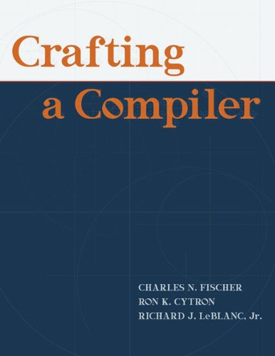
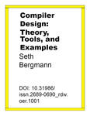
Selected References

Slide 5
Course Objectives
Able to convert any instruction of a program from source language to target language.
Recognize what happens at each and every phase of a compiler.
Specify and analyze the lexical, syntactic and semantic structures of advanced language features.
Understand the different types of parsing techniques.
Understand the concepts related to compilers and should be able to deploy their knowledge in various related fields.

Slide 6
Course Contents
Introduction
Lexical Analysis
Syntax Analysis
Top-Down Parsing
Bottom-Up Parsing
Code Generation
Optimization

Slide 7
Introduction

Slide 8
Outline
Introduction to Compiler.
Phases of Compilers.
Implementation Techniques.

Slide 9
Introduction to Compiler
What is a Compiler?
Recall from your study of assembly language or computer organization the kinds of instructions that the computer’s CPU is capable of executing.
(1) add two numbers stored in memory,
(2) move numbers from one location in memory to another,
(3) move information between the CPU and memory.
But, How computer can see like this instruction?
if (array6[loc]<MAX) sum = 0; else array6[loc] = 0;
Compiler
The function of the compiler is to accept statements such as those above and translate them into sequences of machine language operations

Slide 10
Introduction to Compiler
What is a Compiler?
A compiler is a computer program that translates the code written in one language (high-level language) into an into equivalent other language (low-level or machine language).
The input program is known as the source program, and its language is the source language.
The output program is known as the object program, and its language is the object language.
Notes:
We say that two programs are equivalent if they always produce the same output when given the same input.

Slide 11
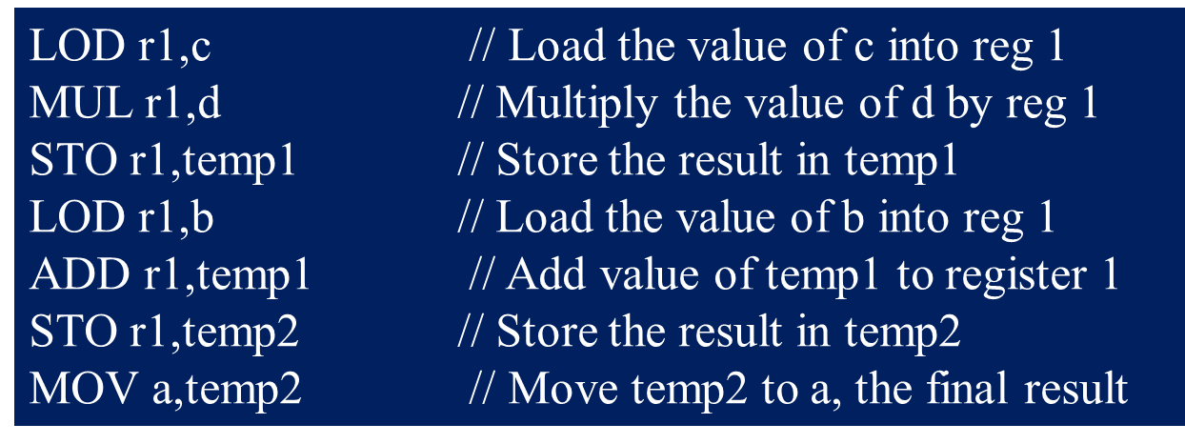
Introduction to Compiler
Example
a = b + c ∗ d;
Source Program
Compiler
Object Program

Slide 12
Introduction to Compiler
Example
Show the output of a Java native code compiler, in any typical assembly language, for the following Java input string:
while (x<a+b) x = 2*x;

Slide 13
Introduction to Compiler
High-Level Languages over Machine or Assembly Language
Machine language (and even assembly language) is diﬃcult to work with and difficult to maintain.
With a high-level language you have a much greater degree of machine independence and portability from one kind of computer to another.
In High-level languages, the programmer does not have complete control of the machine’s resources (registers, interrupts, I/O buﬀers).
The compiler may generate inefficient machine language programs.
Additional software, the compiler, is needed in order to use a high-level language.

Slide 14
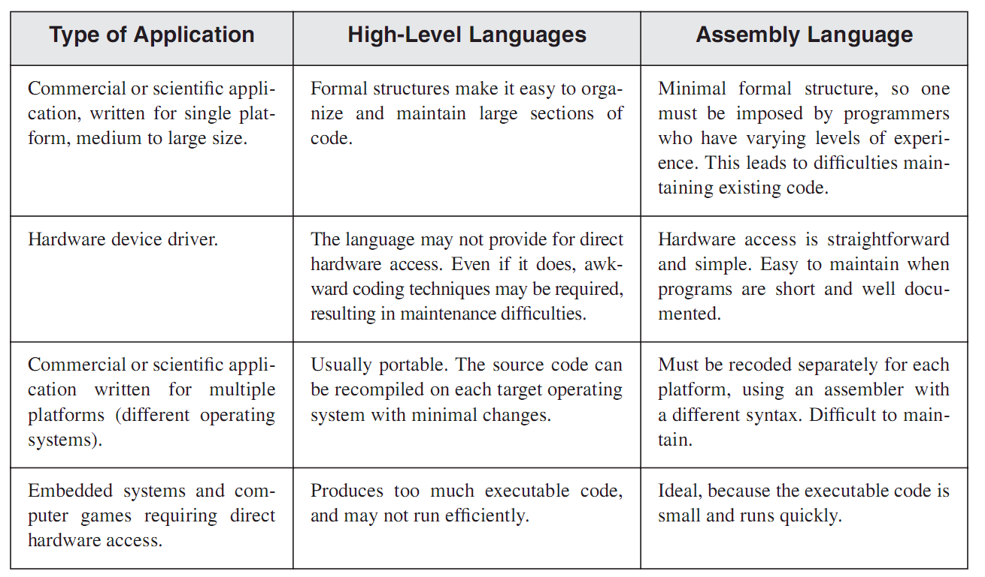
Introduction to Compiler
Applications of High-Level Languages and Machine or Assembly Language

Slide 15
Introduction to Compiler
Compiler & Interpreter
Interpreter – is a computer program that interprets and executes the code written in one language (high-level language) one by one.
A compiler is a computer program that completely translates the code written in one language (high-level language) into an into equivalent other language (low-level or machine language), which then runs on the computer hardware.

Slide 16
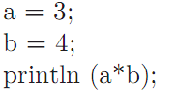
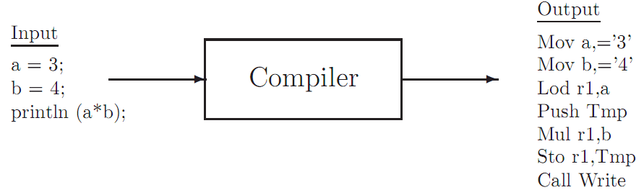
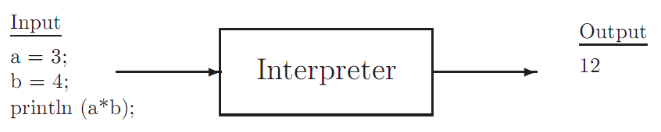
Introduction to Compiler
Example

Slide 17
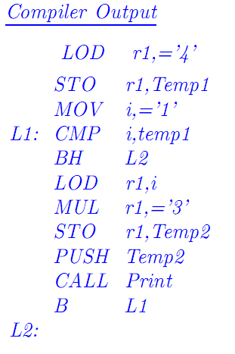
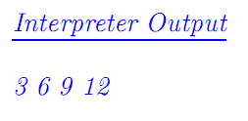
Introduction to Compiler
Example
Show the compiler output and the interpreter output for the following Java source code:
for (i=1; i<=4; i++) System.out.print (i*3);

Slide 18
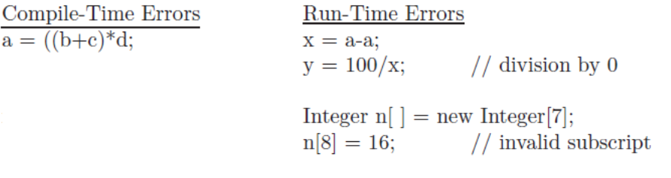
Introduction to Compiler
Compile Time & Run Time
Compile time: The time at which a source program is compiled.
Run time: The time at which the resulting object program is loaded and executed.

Slide 19
Introduction to Compiler
Compiler Language -- Big C notation
It is important to remember that a compiler is a program, and it must be written in some language (machine, assembly, high-level).
In describing this program, we are dealing with three languages:
The source language, i.e. the input to the compiler.
The object language, i.e. the output of the compiler.
The language in which the compiler is written, or the language in which it exists.
A Java compiler for the Mac.
A compiler which translates Java programs to Mac machine language, and which runs on a Sun machine.
A compiler which translates PC machine language programs to Java, written in Ada

Slide 20
Introduction to Compiler
Example
Using the big C notation to show each of the following compilers:
An Ada compiler which runs on the PC and compiles to the PC machine language.
An Ada compiler which compiles to the PC machine language, but which is written in Ada.
An Ada compiler which compiles to the PC machine language, but which runs on a Sun.

Slide 21
Outline
Introduction to Compiler.
Phases of Compilers.
Implementation Techniques.

Slide 22
Phases of Compilers
Phases of Compilers
Lexical Analysis (Scanner)
Syntax Analysis Phase
Global Optimization
Code Generation
Local Optimization
v

Slide 23
Phases of Compilers
Lexical Analysis (Scanner)
The first phase of a compiler is called lexical analysis which generate a stream of tokens as output from source program.
Also, it build a symbol table to store all identifiers used in the source program.
key words - while, void, if, for, ...
identifiers - declared by the programmer
operators - +, -, *, /, =, ==, ...
numeric constants - numbers such as 124, 12.35, 0.09E-23, etc.
character constants - single characters or strings of characters
special characters - characters used as delimiters such as . ( ) , ; :
comments - ignored by subsequent phases. These must be identified by the scanner, but are not included in the output.
Notes:
Symbol table, stores all identiﬁers used in the source program, including relevant information and attributes of the identiﬁers.

Slide 24
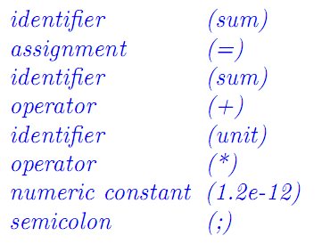
Phases of Compilers
Example
Show the token classes, or “words”, put out by the lexical analysis phase corresponding to this Java source input:
sum = sum + unit * /* accumulate sum */ 1.2e-12 ;

Slide 25
Phases of Compilers
Syntax Analysis
The syntax analysis phase is often called the parser.
The parser will check for the program syntax error and determine the underlying structure of the source program.
The output of this phase may be a stream of atoms or a collection of syntax trees.
For example, (ADD, A, B, C): The meaning of the following atom would be to add A and B, and store the result into C.
=
C
+
A
B

Slide 26
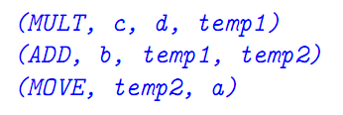
Phases of Compilers
Example
Show the atoms and syntax tree corresponding to the following Java statement:
a = b + c * d ;
Atoms
Syntax Tress

Slide 27
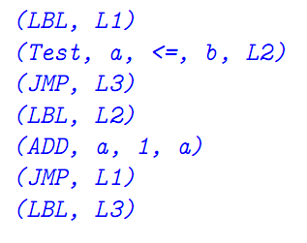
Phases of Compilers
Example
Show the atoms and syntax tree corresponding to the following Java statement:
while (a <= b) a = a + 1;
while
<=
=
a
b
a
+
a
1
Atoms
Syntax Tress

Slide 28
Phases of Compilers
Example
Show the syntax tree corresponding to the following Java statement:
if (a+3 < 400) a =0; else b = a*a;
Note: In syntax trees, each interior node represents an operation or control structure and each leaf node represents an operand.
Notes:
Many compilers also include a phase for semantic analysis. In this phase the data types are checked, and type conversions are performed when necessary.
Type mismatch
Undeclared variable
Reserved identifier misuse.
Multiple declaration of variable in a scope.
Accessing an out of scope variable.
Actual and formal parameter mismatch.

Slide 29
Phases of Compilers
Global Optimization
The global optimization phase is optional. Its purpose is simply to make the object program more efficient in space and/or time.
Examining the sequence of atoms put out by the parser to find redundant or unnecessary instructions or inefficient code.
Since it is invoked before the code generator, this phase is often called machine-independent optimization.

Slide 30
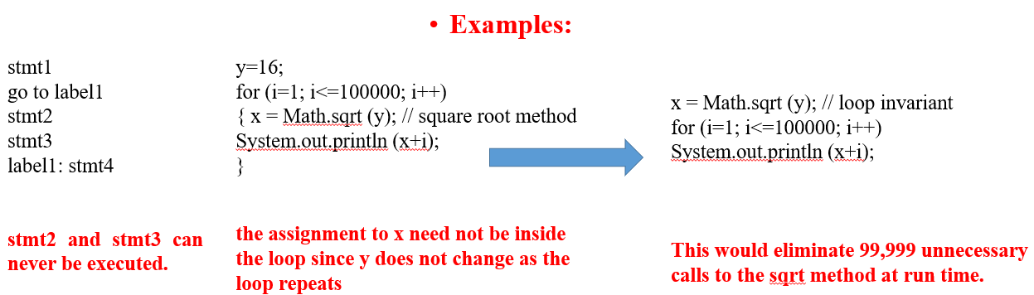
Phases of Compilers
Example
The reader is cautioned that global optimization can have a serious impact on run-time debugging.
Most compilers can turn optimization on or off through debugging.

Slide 31
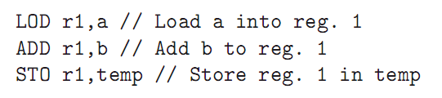
Phases of Compilers
Code Generation
Java compilers produce an intermediate form, known as byte code, which can be interpreted by the Java run-time environment.
But, in this course, we will be assuming that our compiler is to produce native code for a particular machine.
For example, an ADD atom might be translated to three machine language instructions:
Load the first operand into a register.
Add the second operand to that register.
Store the result.
(ADD, a, b,temp)
Notes:
For target machines with several CPU registers, the code generator is responsible for register allocation.
This means that the compiler must be aware of which registers are being used for particular purposes in the generated program, and which become available as code is generated.

Slide 32
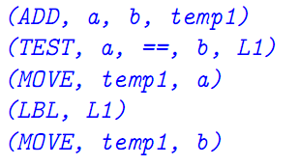
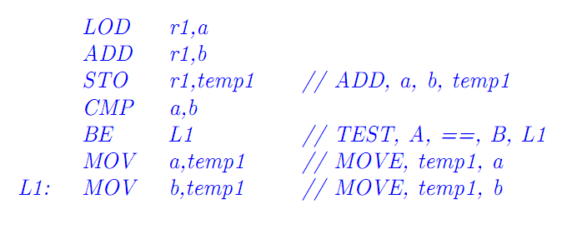
Phases of Compilers
Example
Show assembly language instructions corresponding to the following atom string:

Slide 33
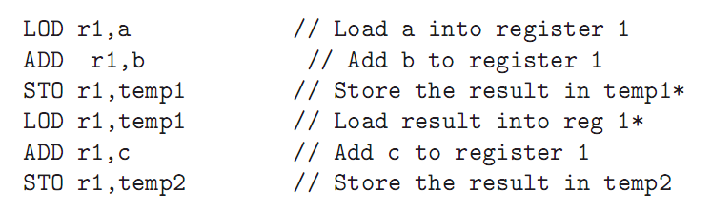
Phases of Compilers
Local Optimization
The local optimization phase is also optional.
It involves examining sequences of instructions put out by the code generator to find unnecessary or redundant instructions.
For this reason, local optimization is often called machine-dependent optimization.
For Example, the expression a + b + c in the source program might result in the following instructions as code generator output:

Slide 34
Outline
Introduction to Compiler.
Phases of Compilers.
Implementation Techniques.

Slide 35
Implementation Techniques
Implementation Techniques of Compiler
A new compiler, with all optimizations, could take over a person-year to implement.
For this reason, we are always looking for techniques or shortcuts which will speed up the development process.
So, we can generate compilers from other compilers that have been developed previously.
Note: If the source program is a compiler which translates language A into language B, then the object program will also be a compiler which translates language A into language B.

Slide 36
Implementation Techniques
Example
Show the output of the following compilation using big C notation:

Slide 37
Implementation Techniques
Bootstrapping
We wish to implement a Java compiler for the Sun computer. Rather than writing the whole thing in machine (or assembly) language, we instead choose to write two easier programs.

Slide 38
Implementation Techniques
Cross Compiling
Notes:
New computers with enhanced (and sometimes reduced) instruction sets are constantly being produced in the computer industry. The developers face the problem of producing a new compiler for each existing programming language each time a new computer is designed. This problem is simpliﬁed by a process called cross compiling.

Slide 39
Implementation Techniques
Compiler-Compilers
Much of compiler design is understood so well at this time that the process can be automated.
It is possible for the compiler writer to write speciﬁcations of the source language and of the target machine so that the compiler can be generated automatically. This is done by a compiler-compiler.
Notes:
Much of compiler design is understood so well at this time that the process can be automated. It is possible for the compiler writer to write speciﬁcations of the source language and of the target machine so that the compiler can be generated automatically. This is done by a compiler-compiler.

Slide 40
Assignments across Course
After the completed each phase in our lecture, each group of students (2-3 students) should implement it regrading one of the available programming languages.

Slide 41
THANKS for your attention

